Slide 1


<Ravi Kiran Upadrasta>
<21 – July - 2023>

Slide 2

Outline
Executive Summary
Introduction
Methodology
Results
Conclusion
Appendix

Slide 3
Executive Summary
Summary of methodologies
Data Collection through API and webscraping
Data Wrangling
Exploratory Data Analysis with SQL and Data Visualizations
Interactive Visual Analytics with Folium and Plotly Dash
Machine Learning Prediction
of all results

Slide 4
Introduction
Project background and context
Falcon 9, rocket designed by SpaceX claims to reduce the cost of rocket launch as it can use the first phase. Depending on various factors like Launch Site, Payload, customer, orbit, SpaceX decides whether to reuse the first stage or not. SpaceY wants to compete with SpaceX on developing a similar rocket. Goal is to create a machine learning pipeline to predict if the first stage will land successfully.
Problems you want to find answers
Factors determining the successful landing of the rocket – like Launch Site, Orbit etc
Relation between these factors, if any
Determine the price of each launch

Slide 5

Section 1

Slide 6
Methodology
Executive Summary
Data collection methodology:
Data Sets were collected using the Space X APIs and web scraping from wikipedia
Perform data wrangling
One hot encoding
Perform exploratory data analysis (EDA) using visualization and SQL
Perform interactive visual analytics using Folium and Plotly Dash
Perform predictive analysis using classification models
Build, tune, evaluate classification models

Slide 7
Data Collection
Describe how data sets were collected.
You need to present your data collection process use key phrases and flowcharts

Slide 8
Data Collection – SpaceX API
Used responses.get to receive data from the SpaceXAPI
Used json_normalize() to convert json response to pandas dataframe
Used API to get specific information for the columns - rocket, payloads, launchpad and cores (functions were pre-defined to get this information). This data is stored in lists
A dictionary is created using the data obtained in step 3 which is then converted to dataframe using pd.Dataframe
Dataframe is filtered to retain only data pertaining to Falcon 9 rocket
Empty Values of Payload Mass are replaced with the mean payload mass.
This data is then exported to a csv file using .to_csv()
#Code snippets are provided in the annexure
https://github.com/istupe/DS_Capstone/blob/main/jupyter-labs-spacex-data-collection-api.ipynb

Slide 9
Data Collection - Scraping
Used requests.get() [HTTP GET method] to request Falcon 9 Wikipedia html page.
A Beautifulsoup object is created from the above response
Used find_all() to get all the tables from the soup object
Iterated through the table headers to extract column names. An empty dictionary is created with all the column names
Parsed the tables to populate the dictionary with values from respective columns
Dictionary converted into dataframe using .DataFrame()
File is exported to csv using .to_csv()
#codesnippets provided in annexures
https://github.com/istupe/DS_Capstone/blob/main/jupyter-labs-webscraping.ipynb

Slide 10
Data Wrangling
Used .value_counts() to determine # of rockets from various launch sites, various orbits and the mission outcomes
Segregated the landing outcomes and created a new column “Class” as a landing outcome label
Found the overall success rate by measuring the mean of the Class column created above.
#codesnippets provided in annexures
https://github.com/istupe/DS_Capstone/blob/main/labs-jupyter-spacex-Data%20wrangling.ipynb

Slide 11
EDA with Data Visualization
Used Data Visualization to identify patterns or trends among the variables and with the dependent variable i.e. launch outcome.
Following Data Visualizations were explored:
Scatter Plot – to understand relation between landing outcome, flight number and payload mass
Scatter Plot – to understand relation between landing outcome, launch site and Flight number
Scatter Plot – to understand relation between payload mass, launch site and landing outcome
Bar Chart – to understand relation between landing outcome and orbit
Scatter Plot – to understand relation between landing outcome, Flight number and orbit
Scatter Plot – to understand relation between landing outcome, payload mass and orbit
Line graph – to understand yearly trend(s) in landing outcome success
#Graphs provided in Section 2
https://github.com/istupe/DS_Capstone/blob/main/jupyter-labs-eda-dataviz.ipynb

Slide 12
EDA with SQL
Used SQL queries to identify the following:
Unique Launch sites in the mission
5 records with Launch Site beginning with the string CCA
Total payload mass carried by boosters launched by NASA (CRS)
Average payload mass carried by booster version F9 v1.1
Date when the first succesful landing outcome in ground pad was acheived
Names of the boosters which have success in drone ship and have payload mass greater than 4000 but less than 6000
Total number of successful and failure mission outcomes
Names of the booster_versions which have carried the maximum payload mass
Records which will display the month names, failure landing_outcomes in drone ship ,booster versions, launch_site for the months in year 2015.
Rank the count of landing outcomes
https://github.com/istupe/DS_Capstone/blob/main/jupyter-labs-eda-sql-coursera_sqllite.ipynb

Slide 13
Build an Interactive Map with Folium
Marked and added all launch sites as circles, success or failure of launches as markers and distance from railway line, airport, sea and city as lines. Added these objects to answer few questions like
Are the launch sites in proximity to equator (similar latitudes) or a coast – YES. The launch sites are either on west coast or east coast of the United States
Color coding the markets (0 or failure as red and 1 or success as green) helped in identifying performance of a launch site.
Distances to understand if launch sites are closer or farther from railways, highways, coastline or nearest city – Launch Sites seem closer to railways, highways and coastline but seem far from cities
https://github.com/istupe/DS_Capstone/blob/main/lab_jupyter_launch_site_location.ipynb
To view along with maps use the nbviewer link as github isn’t rendering maps
https://nbviewer.org/github/istupe/DS_Capstone/blob/main/lab_jupyter_launch_site_location.ipynb

Slide 14
Build a Dashboard with Plotly Dash
Built a dashboard with option to input a) Launch Site as dropdown and b) Payload Mass as a slider
When the Launch Site is selected, It shows a pie chart of the total launches from the selected site with distribution between successful and unsuccessful launches.
Then we created a scatter plot with inputs as Launch Site (From dropdown) and Payload mass (from slider) and output indicating correlation between payload and success.
https://github.com/istupe/DS_Capstone/blob/main/spacex_dash_app.py

Slide 15
Predictive Analysis (Classification)
1) Created a numpy array from dataframe using to_numpy(). Standardized the data using transform and split the data into training and testing with test size of 20%
2) Built different machine learning models (Logistic Regression, SVM, Decision tree Classifer, and K Nearest Neighbours) with hyperparameters using GridSearchCV.
3) Calculated the accuracy of the models using score and plotted the confusion matrix to identify the best method
https://github.com/istupe/DS_Capstone/blob/main/SpaceX_Machine_Learning_Prediction_Part_5.jupyterlite.ipynb

Slide 16
Results
Exploratory data analysis results
Interactive analytics demo in screenshots
Predictive analysis results
These are presented in Section 2 of the presentation

Slide 17

Section 2

Slide 18
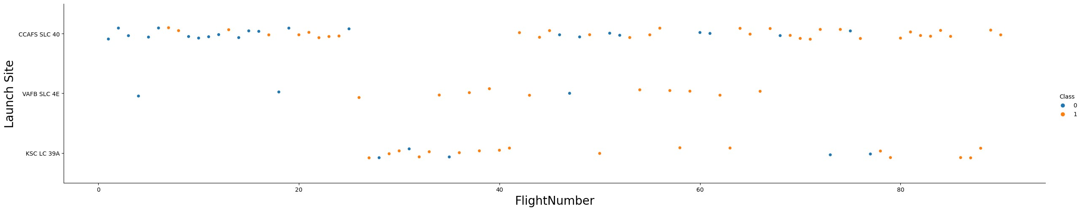
Flight Number vs. Launch Site
From the Visualization we can notice that:
1) Earlier flights lauch were from CCAFS-SLC-40 site ,Followed by KSC-LC-39A
2) Most Launches are Launched from CCAFS-SLC-40 and least Launches from VAFB SLC 4E
3) For a brief period during Launches 20 to 40, launches were shifted from CCAFS SLC 40 to KSC LC 39A

Slide 19
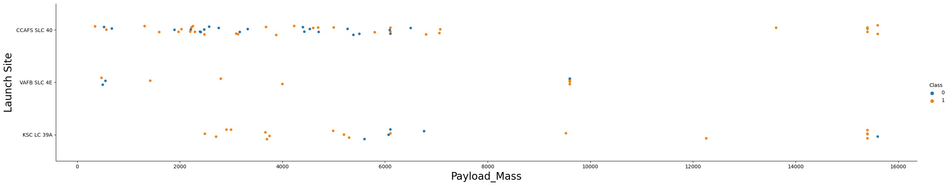
Payload vs. Launch Site
From the Visualization we can notice that:
Payloads over 10000 KG are not launched at VAFB SLC 4E
Higher payloads (above 14000 kg) seem to have higher success rate

Slide 20
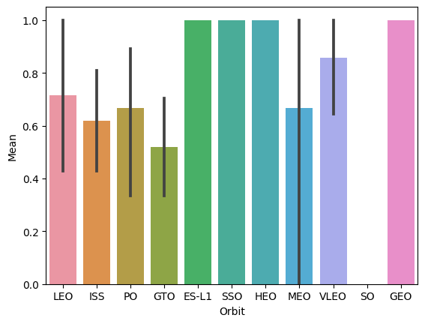
Success Rate vs. Orbit Type
From the Visualization we can notice that:
1) ES-L1, GEO, HEO, SSO, VLEO had the most success rate.

Slide 21
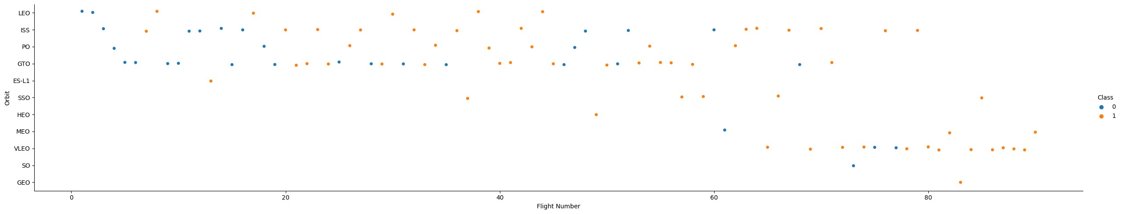
Flight Number vs. Orbit Type
From the Visualization we can notice that:
VLEO orbit flights came much later but have good success rate along with SSO orbit
Initially lot of failures in GTO and ISS orbit launches
GTO and ISS also seem to have the most launches followed by VLEO

Slide 22
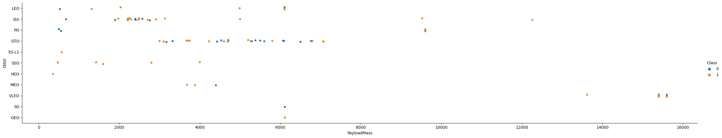
Payload vs. Orbit Type
From the Visualization we can notice that:
Most of the ISS payloads are between 2000 to 4000. Most of the GTO payloads are between 3000 and 7000. VLEO has only higher payloads. HEO, ES-L1 and have very small payloads
With heavy payloads the successful landing or positive landing rate are more for Polar,LEO and ISS.
For GTO we cannot distinguish this well as both positive landing rate and negative landing(unsuccessful mission) are both there here.

Slide 23
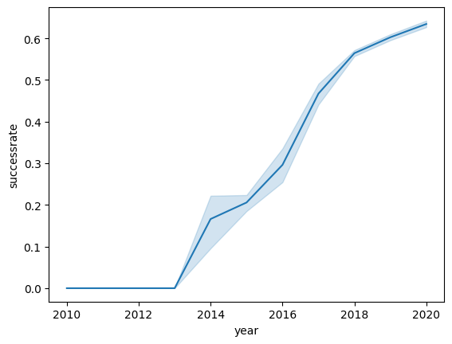
Launch Success Yearly Trend
From the Visualization we can notice that:
Success rate kept increasing from 2013 onwards

Slide 24
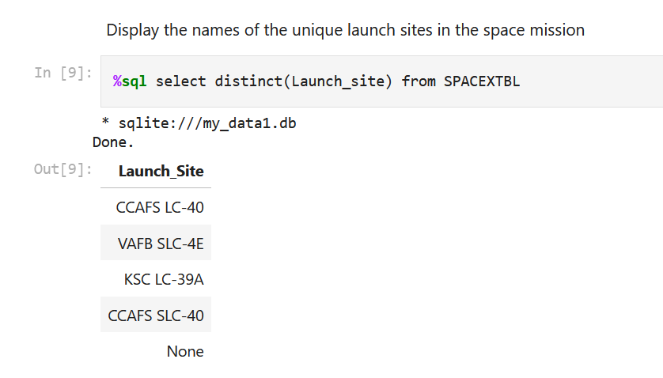
All Launch Site Names
To get the unique launch sites, we used distinct (launch_site) from the database. There are 4 unique launch sites

Slide 25
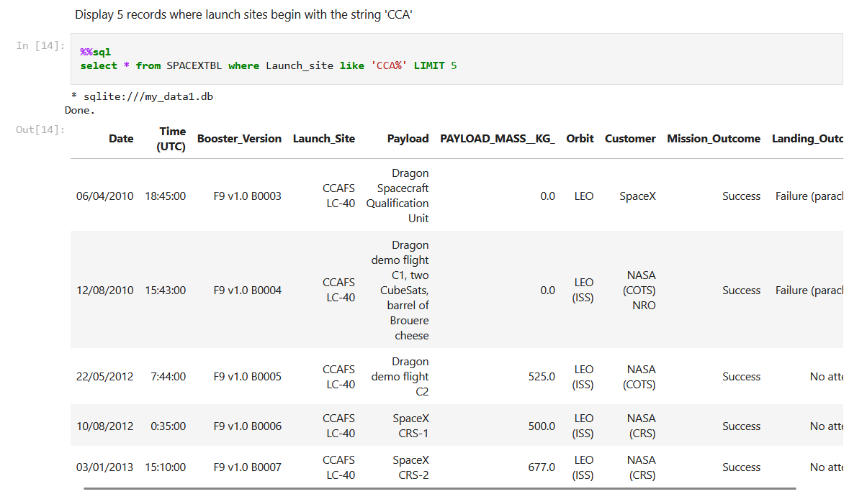
Launch Site Names Begin with 'CCA'
We used the condition Launch_site like ‘CCA%’ to identify launch sites whose name begins with CCA and limited to 5 records using LIMIT keyword

Slide 26
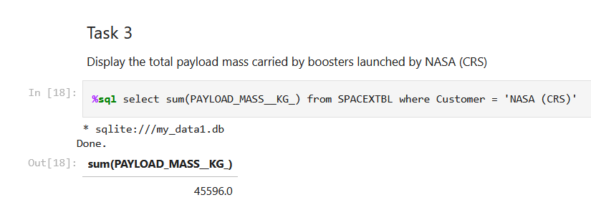
Total Payload Mass
Used the Sum(Payload_mass__Kg_) with the condition that customer is NASA (CRS) to calculate total payload

Slide 27
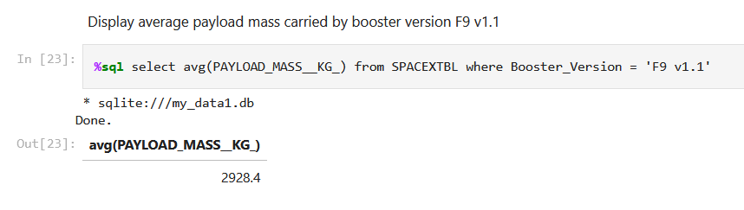
Average Payload Mass by F9 v1.1
Used the Avg(Payload_mass__Kg_) with the condition that Booster_Version is F9 v1.1 to calculate average payload

Slide 28
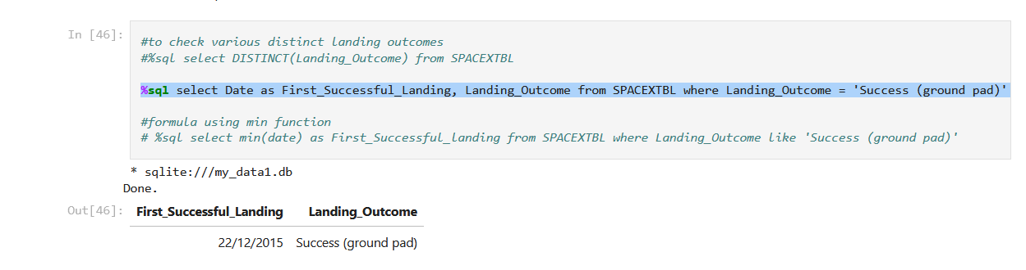
First Successful Ground Landing Date
We can get the required result by either query
%sql select Date as First_Successful_Landing, Landing_Outcome from SPACEXTBL
where Landing_Outcome = 'Success (ground pad)' order by Date desc LIMIT 1
or
%sql select min(date) as First_Successful_landing from SPACEXTBL
where Landing_Outcome like 'Success (ground pad)'

Slide 29
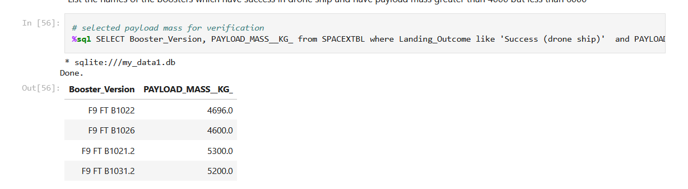
Successful Drone Ship Landing with Payload between 4000 and 6000
%sql SELECT Booster_Version, PAYLOAD_MASS__KG_ from SPACEXTBL
where Landing_Outcome like 'Success (drone ship)' and PAYLOAD_MASS__KG_ between 4000 and 6000

Slide 30
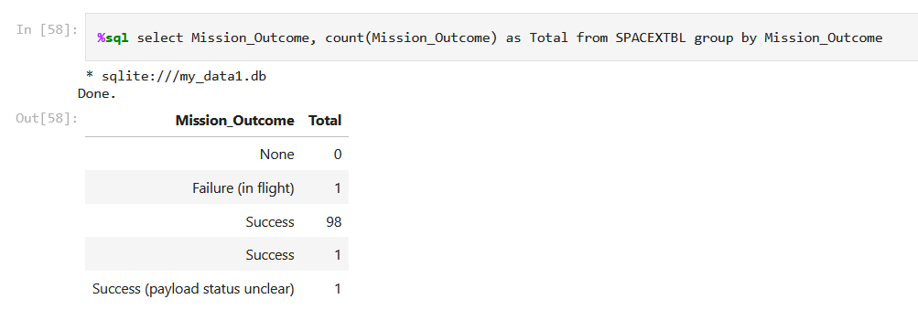
Total Number of Successful and Failure Mission Outcomes
Used count of mission_outcome to get the number of successful and
failure mission outcomes

Slide 31
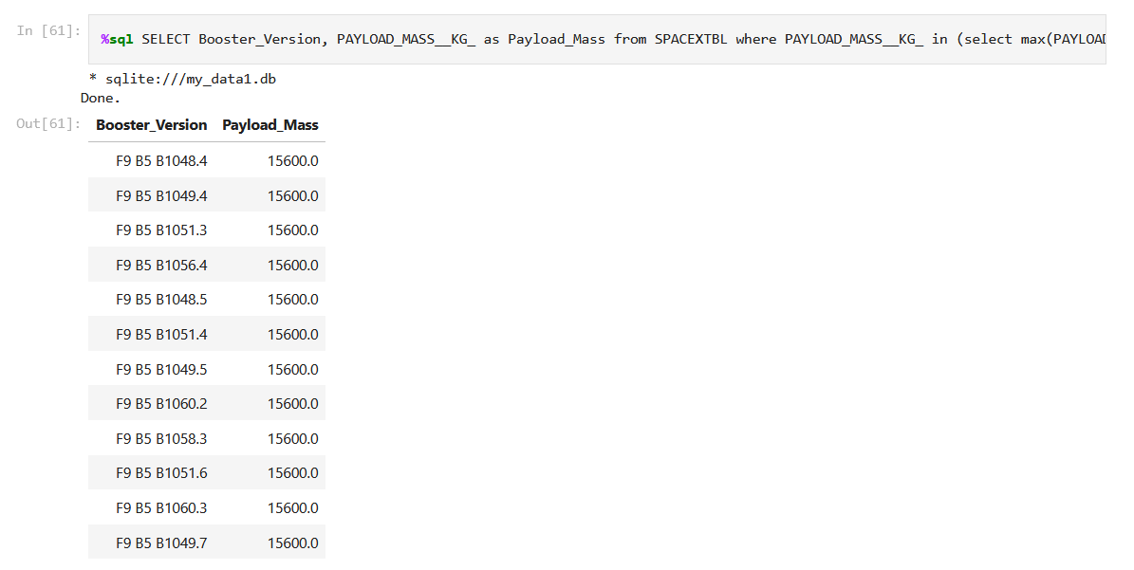
Boosters Carried Maximum Payload
%sql SELECT Booster_Version, PAYLOAD_MASS__KG_ as Payload_Mass from SPACEXTBL
where PAYLOAD_MASS__KG_ in (select max(PAYLOAD_MASS__KG_) from SPACEXTBL)
Used a subquery to get the maximum payload and used it to match with payload to get the boosters carrying max payload

Slide 32
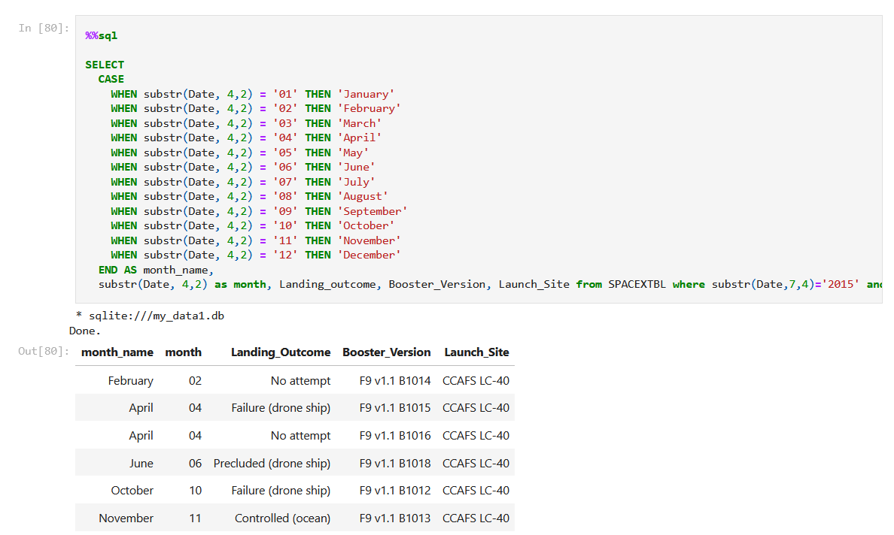
2015 Launch Records
substr(Date, 4,2) as month, Landing_outcome, Booster_Version, Launch_Site from SPACEXTBL where substr(Date,7,4)='2015' and Landing_Outcome not like '%Success%' order by month
To get the failure landing outcomes, used CASE to get the name of the month with the extracted month number,
Used where for identifying year and landing outcome doesn’t contain the word success
Results ordered by month chronologically

Slide 33
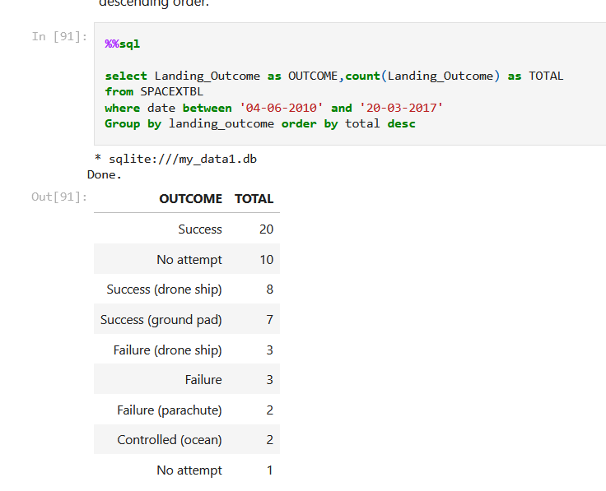
Rank Landing Outcomes Between 2010-06-04 and 2017-03-20
To get the landing outcomes by ranking, we used count to get the total landing outcomes
Then used group by which groups as per the landing outcome
Used order by the count of landing outcomes and sorted using desc

Slide 34

Section 3

Slide 35
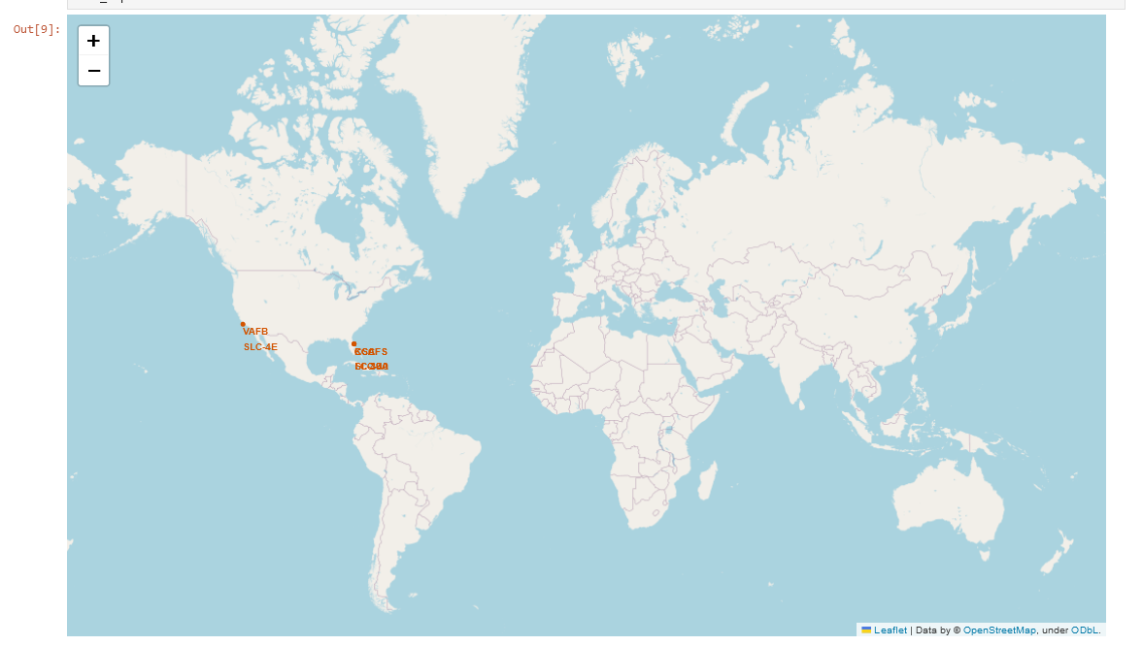
Global Launch Sites of SpaceX
The launch sites of SpaceX are on the west and east coasts of the United States

Slide 36
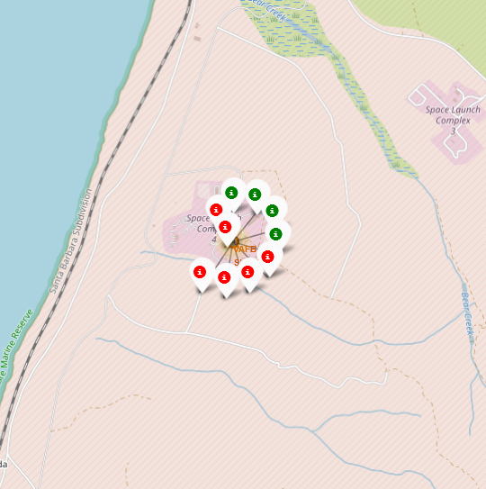
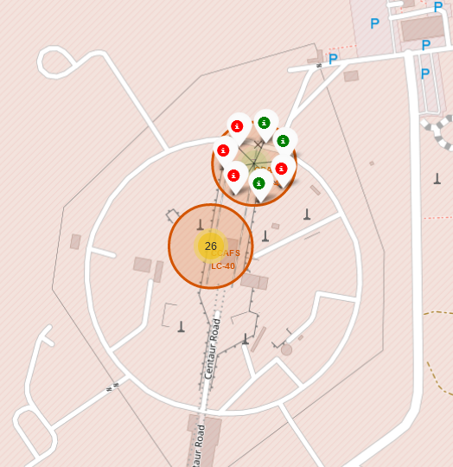
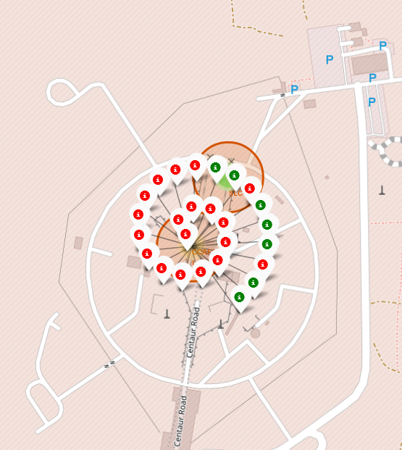
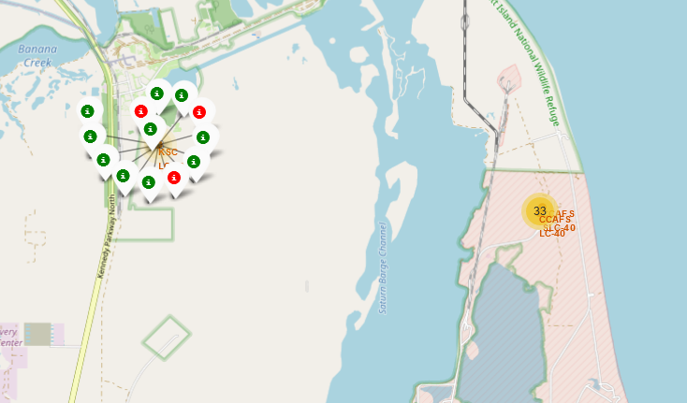
Launch Sites and Outcomes of Launches
VAFB SLC 4E
CCFAS SLC 40
The four screenshots provide the locations of launch sites along with the outcomes of launches as markers. Red marker means a failure and green marker means success
KSC LC 39A
CCFAS LC 40

Slide 37
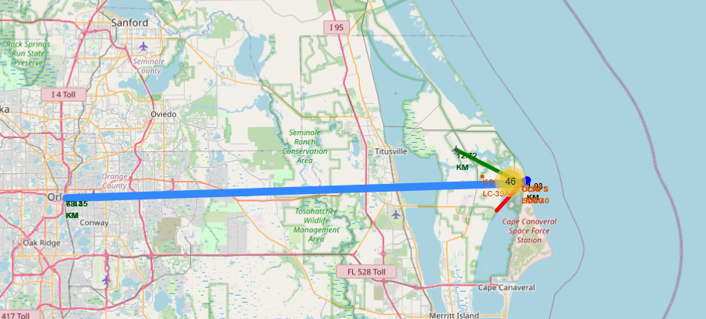
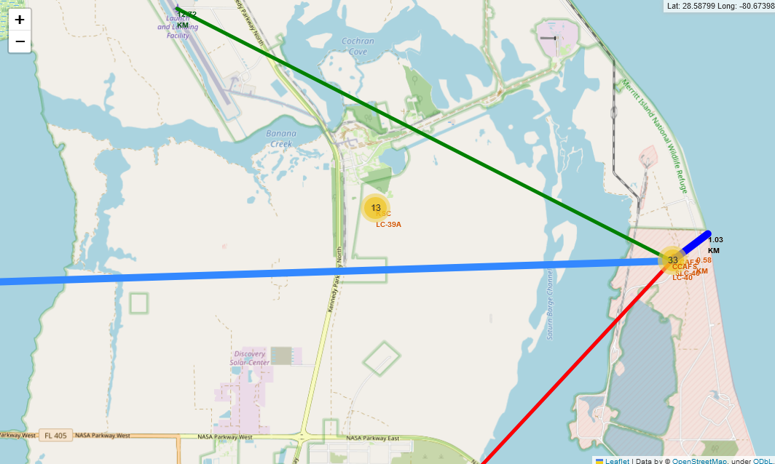
Launch Site proximities and connectivity
We have mapped the distance from the launch site to coast line, Nasa Parkway east highway, Launch and Training Facility airport and Orlando city. Distances and lines are drawn on the map.
Launch site is close to the coast, airport and highway but far from the city

Slide 38

Section 4

Slide 39
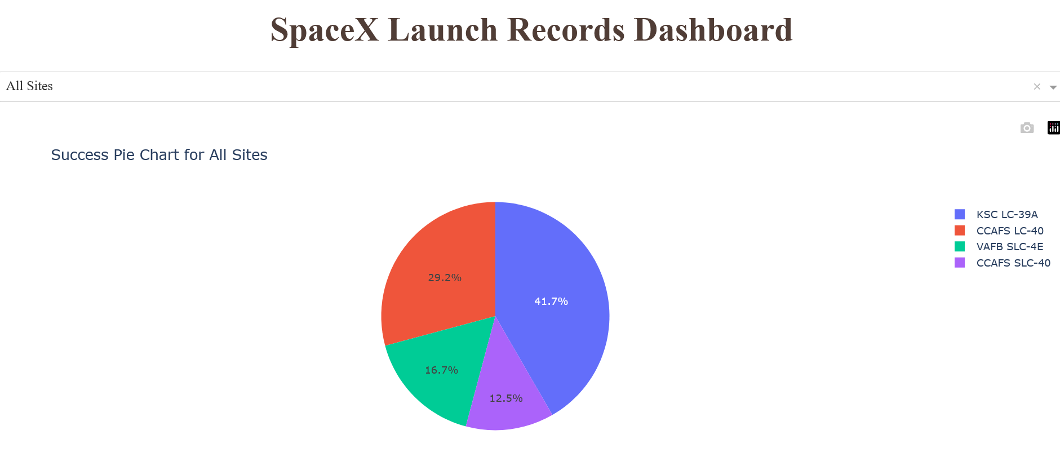
Success Pie chart for all sites
KSC-LC-39A had contributed to the most successful launches followed by CCAFS LC 40

Slide 40
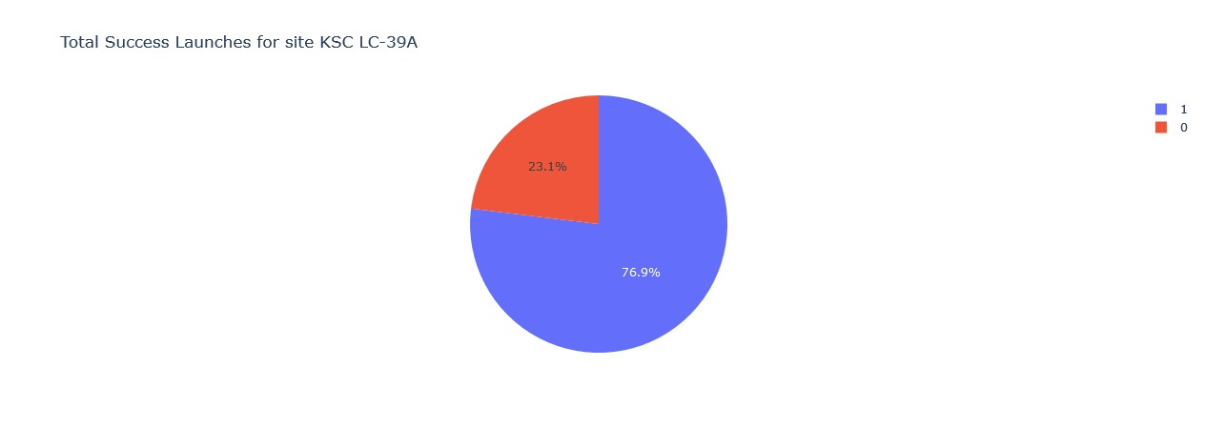
Launch Site with highest success ratio
KSC-LC-39A – 76.9% of the launches at the site were successful

Slide 41
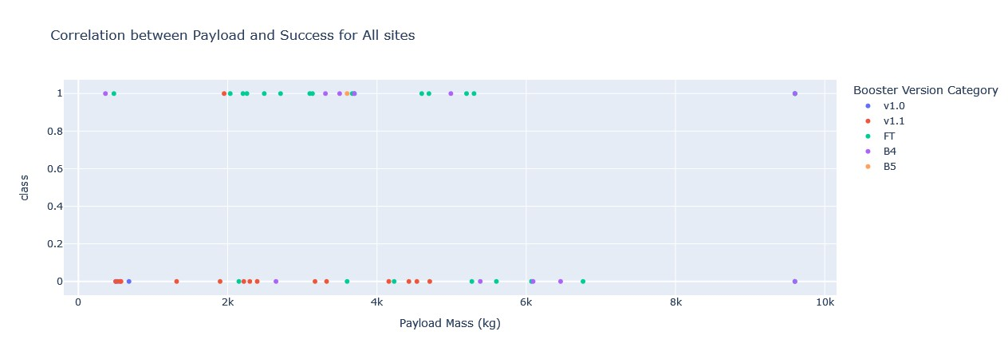
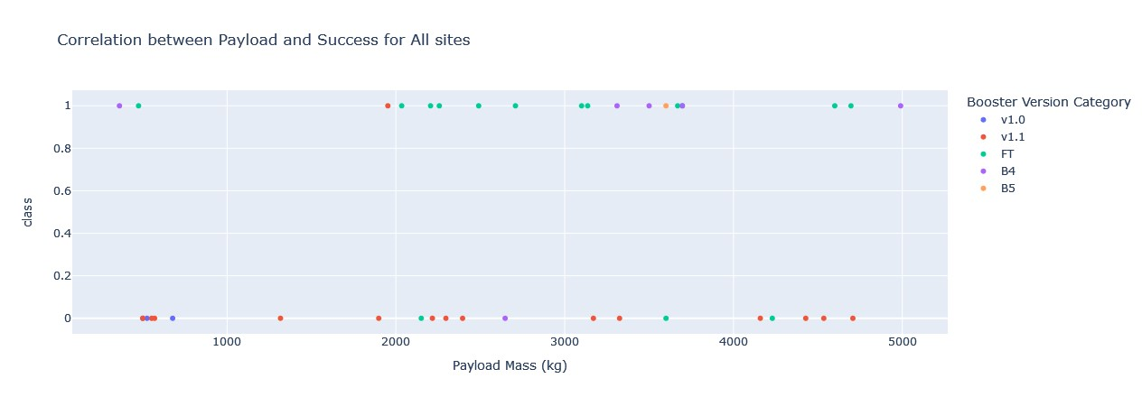
Scatter Plot – Payload vs Launch Outcome – All Sites
Two graphs are presented plotting Payload Mass vs Class for all sites with each dot color-coded as per booster version.
Above graph is for all payloads while below is for payloads till 5000 kg
- FT has more success rate below 5000kg payload
- Most v1.1 launches are failures irrespective of payload

Slide 42

Section 5

Slide 43
Classification Accuracy
Accuracy scores of the algorithms on train and test data are plotted above. It can be seen that Decision tree algorithm has the best classification accuracy

Slide 44

Confusion Matrix
The confusion matrix for the decision tree classifier shows that the classifier can distinguish between the different classes.
The model has identified 15 outcomes accurately.
There are no false negatives i.e., model did not predict unsuccessful landing when there is successful landing
The major problem is the false positives .i.e., unsuccessful landing marked as successful landing by the classifier.

Slide 45
Conclusions
The larger the flight number, the greater the success rate.
Launch success rate started to increase in 2013 till 2020.
Orbits ES-L1, GEO, HEO, SSO, VLEO had the most success rate. Payloads over 10000 KG are not launched at VAFB SLC 4E
KSC LC-39A had the most successful launches of any sites with 77% success rate.
Launch Sites are on the coastal areas, close to transport like highways but far from cities.
The Decision tree classifier is the best machine learning algorithm for this task.

Slide 46
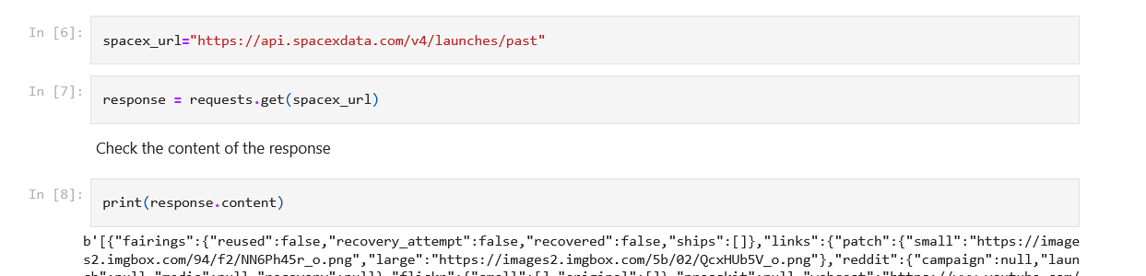
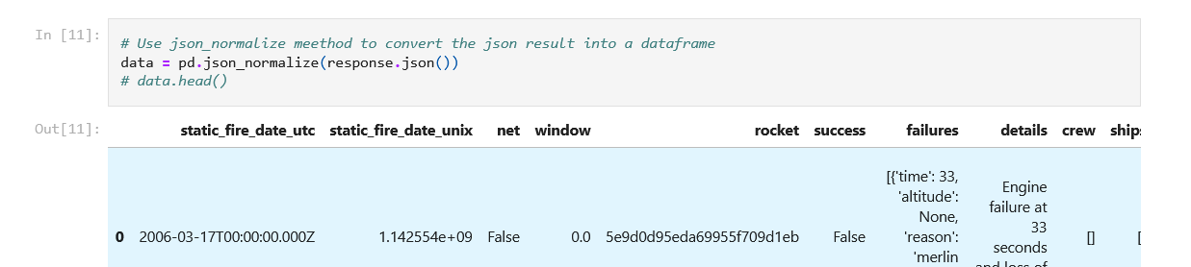
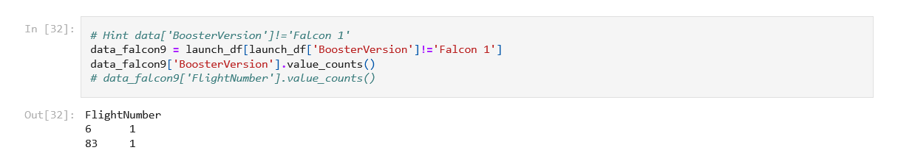
Appendix – Code Snippets – Data Collection API
Used responses.get to receive data from the SpaceX API
https://github.com/istupe/DS_Capstone/blob/main/jupyter-labs-spacex-data-collection-api.ipynb
Used json_normalize to convert into datframe
Remove Falcon 1 Launches from the data

Slide 47
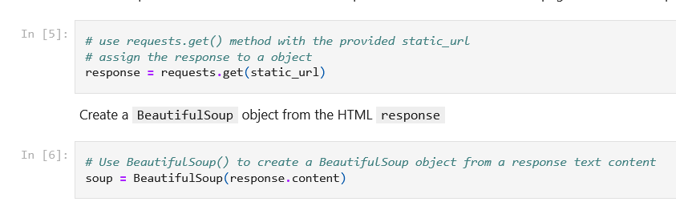
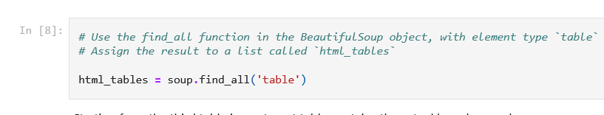
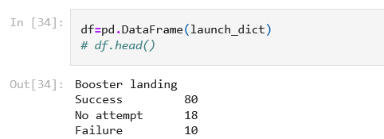
Appendix – Code Snippets – Data Collection Scraping
Used requests.get to get data from webpage
Created a beautiful soup object
Used find_all to get the tables
https://github.com/istupe/DS_Capstone/blob/main/jupyter-labs-webscraping.ipynb
Converted dictionary to dataframe

Slide 48
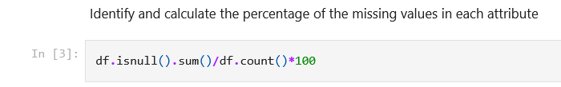
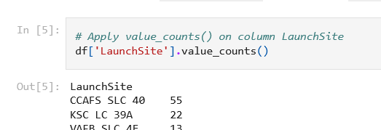
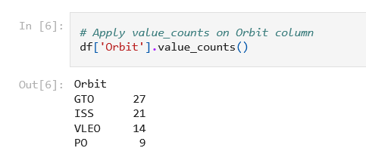
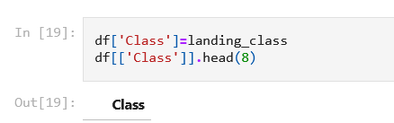
Appendix – Code Snippets – Data Wrangling
Calculating missing values
Launches against launch sites
Launches in orbits
Creating a column Class to identify whether launch is success or failure

Slide 49


